Slide 1
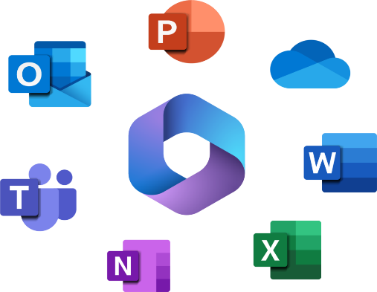

Introduction to Microsoft and Microsoft 365
Chapter 3

Slide 2

LEARNING OUTCOMES
By the end of this session, students should be able to;
  Microsoft 365
  Word
  Excel
  PowerPoint
  Outlook

Slide 3
INTRODUCTION
For decades, the name Microsoft Office has been synonymous with productivity software, representing the essential desktop applications( Word, Excel, PowerPoint and Outlook that became the global standard for document creation, data analysis, presentation and email. This traditional office suite model, centered on a one time purchase for a static version of the software has evolved into Microsoft 365.Microsoft 365 is a comprehensive cloud powered subscription service while retaining the familiar core applications and always transforms them into always updated, collaborative tools integrated with cloud storage, advanced security and a suite connected services, marking a fundamental shift from standalone software to a dynamic, intelligent platform for modern work.

Slide 4
Microsoft 365
Microsoft 365 is a cloud-powered subscription service offering the latest Office apps. This office application consists of Word, Excel, PowerPoint, Outlook, Teams, etc., cloud storage known as OneDrive, security features, and AI tools (Copilot) for individuals, families, and businesses. Microsoft 365 provides ongoing updates and access across multiple devices (PCs, Macs, tablets, phones) as opposed to a one-time purchase. You will have to pay annual subscription fee via credit card, PayPal or Microsoft gift card to use Microsoft 365. We highly recommend using our ITI lab computers installed with Microsoft 365 to gain full experience and improve your computer skills and knowledge. Lastly, note that Other Office 2010, Office 2013, Office 2016 or Office 2019 are older versions or out-of-date versions of Office 365.

Slide 5
Word
Microsoft Word 2019 is the latest version of the most popular word processing application developed by Microsoft Corporation. Other versions of Microsoft Office Applications used in the market are 2010, 2013 and 2016. Regardless of what versions you use, word processing program is widely used in personal and business activities. This course will show you many ways on how you can integrate Word processing 2019 into your everyday life.
In this course, you are going to learn how to...
Understand what Word Processing is
Know Word Features
Explore the Word
Check Grammar
Check Spelling
Use Word Wrap

Slide 6

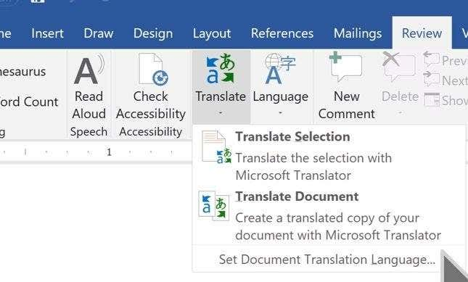
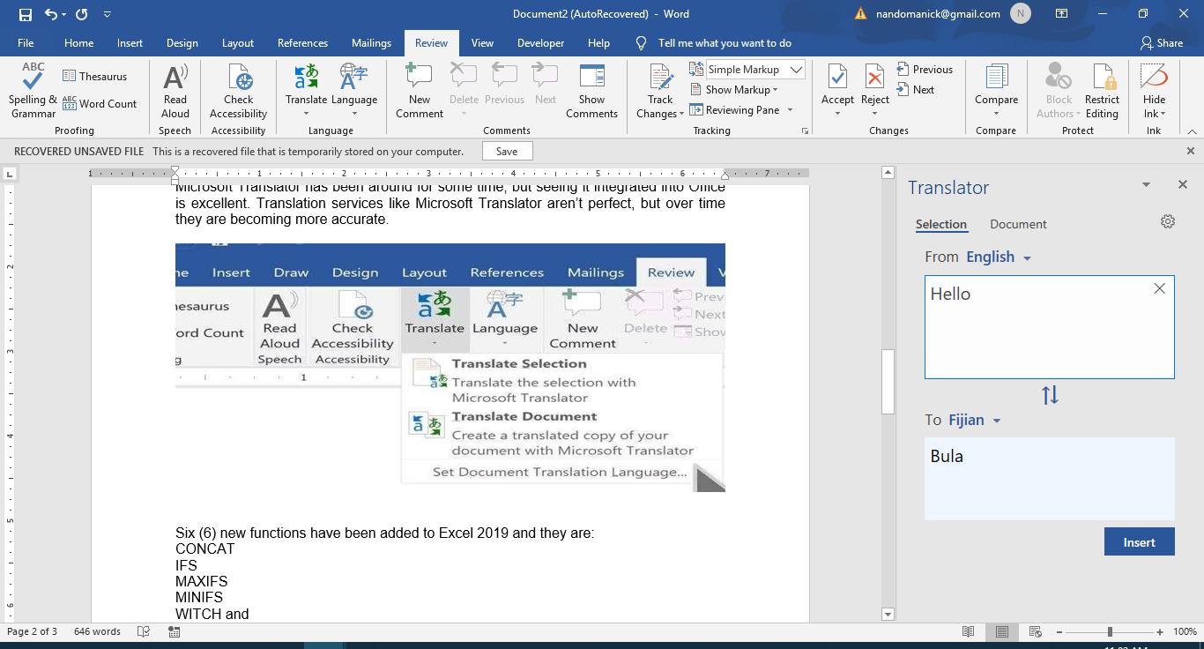
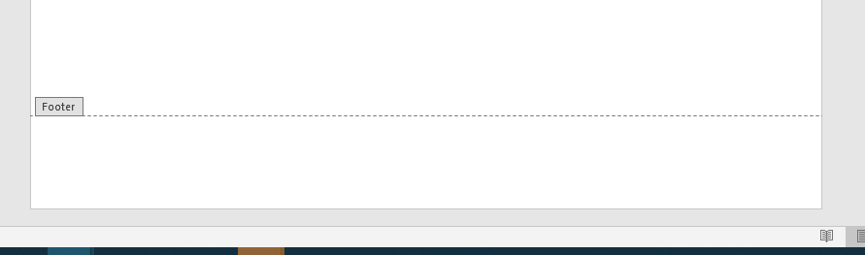
Some new features in Word 2019
Some new features in Word 2019
1. Tell Me is a new feature which ask your o to type a command to access it instantly as show below in Fig 3.1.
2. Microsoft Translator is also a new feature added to Word, Excel and PowerPoint. To access it, open the Review tab in your document and then click the new Translate and Language buttons. From here, you’ll have the opportunity to translate the entire document or translate a selected portion of text.
Microsoft Translator has been around for some time, but seeing it integrated into Office is excellent. Translation services like Microsoft Translator aren’t perfect, but over time they are becoming more accurate as shown below in Fig 3.3.
Figure 3.1 showing Tell Me command from Home Tab
For example, if you type Footer in Tell me what you to do in search for text box, Word 2019 will automatically activate Footer section thus allowing you to type in Footer text as shown in Fig 3.2 below
Figure 3.2 showing Footer section
Figure 3.3 showing Translate command from Review Tab.
For example, the word Hello in English is translated to Bula in Fiji.

Slide 7
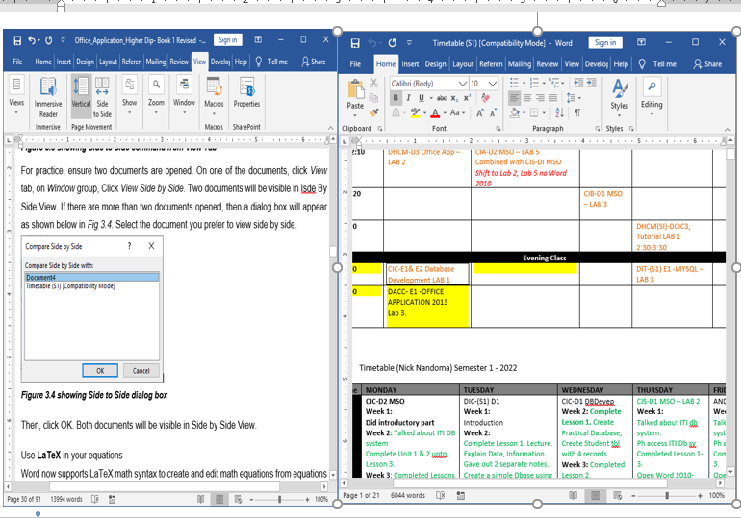
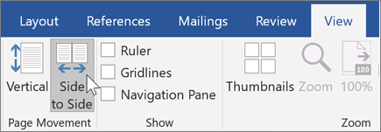
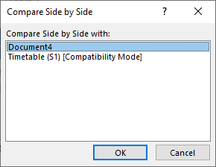
Exploring Microsoft Word
View a page at a time, side by side
Instead of scrolling continuously, flip through pages like a book with Side to Side view. On a touch screen, you use your finger to page through your document. The horizontal scroll bar—or your mouse wheel—gives you book-style navigation as shown below in Fig 3.4.
For practice, ensure two documents are opened. On one of the documents, click View tab, on Window group, Click View Side by Side. Two documents will be visible in Side by Side View as shown in FigMicrosoft
Figure 3.4 showing Side to Side command from View Tab
If there are more than two documents opened, then a dialog box will appear as shown below in Fig 3.6. Select the document you prefer to view side by side. Then, click OK. Both documents will be visible in Side by Side View.
Figure 3.5 showing Side to Side from two documents.
Figure 3.6 showing Side to Side dialog box

Slide 8
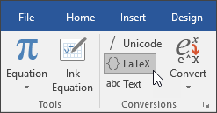
Use LaTeX in your equations
Word now supports LaTeX math syntax to create and edit math equations from equations using Insert tab as shown below in Fig 3.7.
Figure 3.7 showing LaTeX command from Equation from Insert Tab

Slide 9
Excel
Microsoft Excel 2019 is the latest version of popular spreadsheet software developed by Microsoft Corporation. Older versions are 2010, 2013 and 2016.
Microsoft Excel allows users to create spreadsheet to store data, organize, sort, calculate and create charts using data. It is important to know its features first before using the spreadsheet.
In this course, you are going to learn how to...
Define electronic spreadsheet
Know excel
Explore the Excel Window
Explore Workbook Window
Move around the worksheet
Enter formulas and functions

Slide 10
Format Worksheet
Charting Worksheet
Working with Charts
Managing and Analyzing Workbook
Working with Sheets
Sharing and Copying between applications
Some new features in Excel 2019
New Functions
CONCAT
IFS
MAXIFS
MINIFS

Slide 11
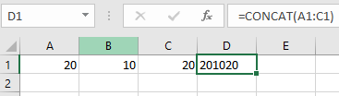
CONCAT FUNCTION
CONCAT is similar to CONCATENATE, but it now supports range references, not just individual cell references.
For example: To concatenate the values in A1, B1, and C1, you can use a range like this: = CONCAT (A1:C1)
This present the values in cell A1, B1 and C1 as 201020.

Slide 12
IFS FUNCTION
The IFS function, conditions are tested in the order that you specify. If passed, the result is returned. The IFS function checks whether one or more conditions are met, and returns a value that corresponds to the first TRUE condition. IFS can take the place of multiple nested IF statements, and is much easier to read with multiple conditions.
For example: To calculate the Grade for the students. Instead of using multiple nested IF statements, IFS function is used.
Those with “F” grade doesn’t meet the prior conditions.
“TRUE” and its corresponding value “F” provide a default value because other conditions aren’t met.
The formula for cells A2:A9 is:
=IFS(A2>=80,"A”, A2>=70,"B”, A2>=60,"C”, A2>=50,"D”, TRUE,"F")
Which says IF (A2 is Greater Than OR Equal to 80, then return a "A", IF A2 is Greater Than or Equal 70, then return a "B", and so on and for all other values less than 50, return an "F").

Slide 13
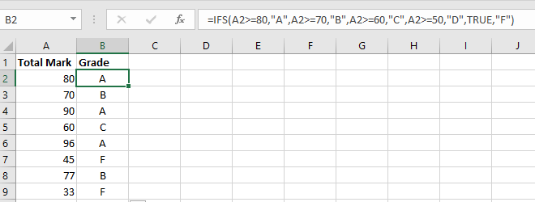

Slide 14
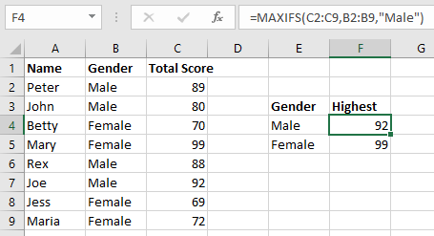
MAXIFS FUNCTION
MAXIFS can be used to return the largest number in a range – you can also set the returned result to only be a number that meets certain criteria. MINIFS is the same, but it will return the smallest number.
The syntax of the MAXIFS function is as follows:
MAXIFS (max_range, criteria_range1, criteria1, [criteria_range2, criteria2], …)
Where:
Max_range (required) - the range of cells where you want to find the maximum value.
Criteria_range1 (required) - the first range to evaluate with criteria1.
Criteria1 - the condition to use on the first range. It can be represented by a number, text or expression.
Criteria_range2 / criteria2, …(optional) - additional ranges and their related criteria. Up to 126 range/criteria pairs are supported.
Example: The Excel MAXIFS function returns the largest numeric value that meets one or more criteria in a range of values.
Max_range (C2:C9)
Criteria_range (B2:B9)
The criteria used here is “Male” OR “Female” will give this formula
=MAXIFS (C2:C9, B2:B9,” Male”)

Slide 15
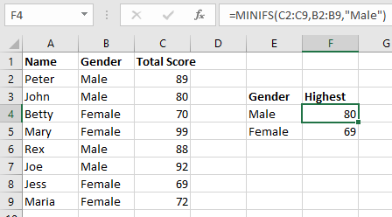
MINIFS FUNCTION
MINIFS can be used to return the smallest number in a range – you can also set the returned result to only be a number that meets certain criteria. MINIFS is the same, but it will return the smallest number.
The syntax of the MINIFS function is as follows:
MINIFS (min_range, criteria_range1, criteria1, [criteria_range2, criteria2], …)
Where:
Min_range (required) - the range of cells where you want to find the minimum value.
Criteria_range1 (required) - the first range to evaluate with criteria1.
Criteria1 - the condition to use on the first range. It can be represented by a number, text or expression.
Criteria_range2 / criteria2, …(optional) - additional ranges and their related criteria. Up to 126 range/criteria pairs are supported.
Example: The Excel MINIFS function returns the smallest numeric value that meets one or more criteria in a range of values.
Min_range (C2:C9)
Criteria_range (B2:B9)
The criteria used here is “Male” OR “Female” will give this formula
=MINIFS (C2:C9, B2:B9,” Male”)

Slide 16
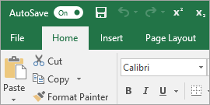
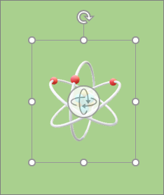
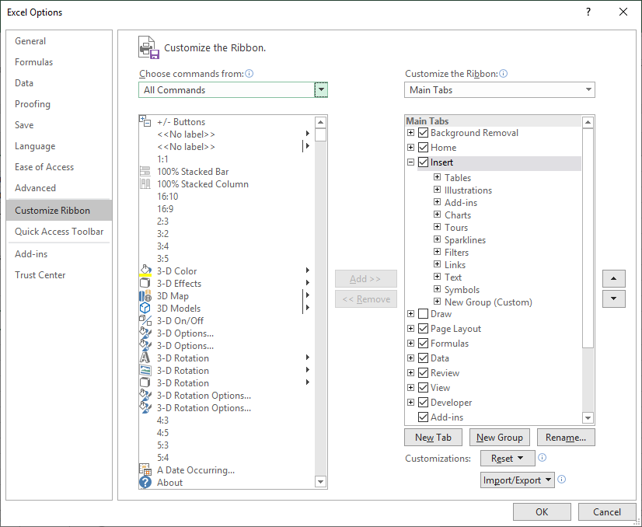
rrrrr
Insert 3D models in Excel allows you to see all the angles to increase the visual and creative impact of your workbooks. Easily insert a 3D model, then you can rotate it through 360 degrees as shown below in Fig 3.5
Quick access to superscript and subscript commands can be customized by adding them to the Ribbon or Quick Access Toolbar as shown below in Fig 3.6.
Figure 3.6 showing how to add superscript and subscript from File tab.
Click File tab>Options>Customize Ribbon>Select All Commands

Slide 17
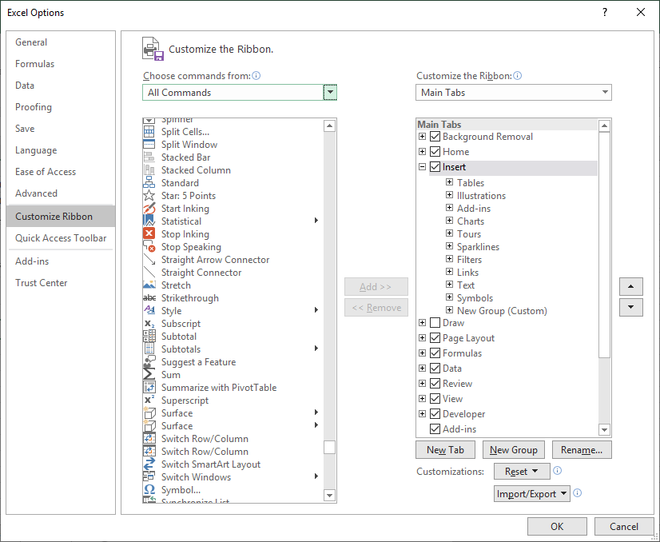
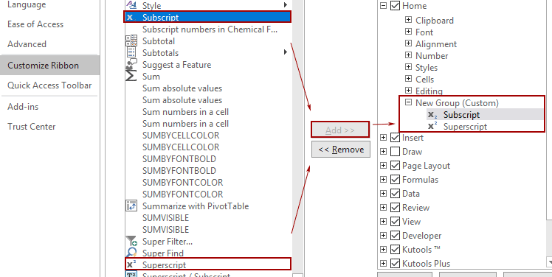
Scroll down and select Superscript and ADD to a new group. It will appear on the Ribbon and simply select it and add to
Quick Access Tool.
Quick access to superscript and subscript commands
Figure 3.7 showing how to add superscript from Customize Ribbon.

Slide 18
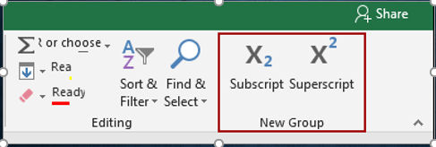
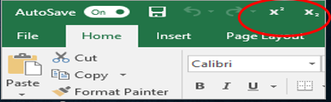
Now you have added the Subscript and the Superscript features to the ribbon as shown below in Figure 3.8 and 39.
From now on, you just need to select a character, and then, click on the Subscript or Superscript to make it work
Figure 3.8 showing superscript and subscript added to Ribbon.
Superscript & Subscript at Quick Access Toolbar
Figure 3.9 showing superscript and subscript added to Quick Access Toolbar.
Improved autocomplete

Slide 19
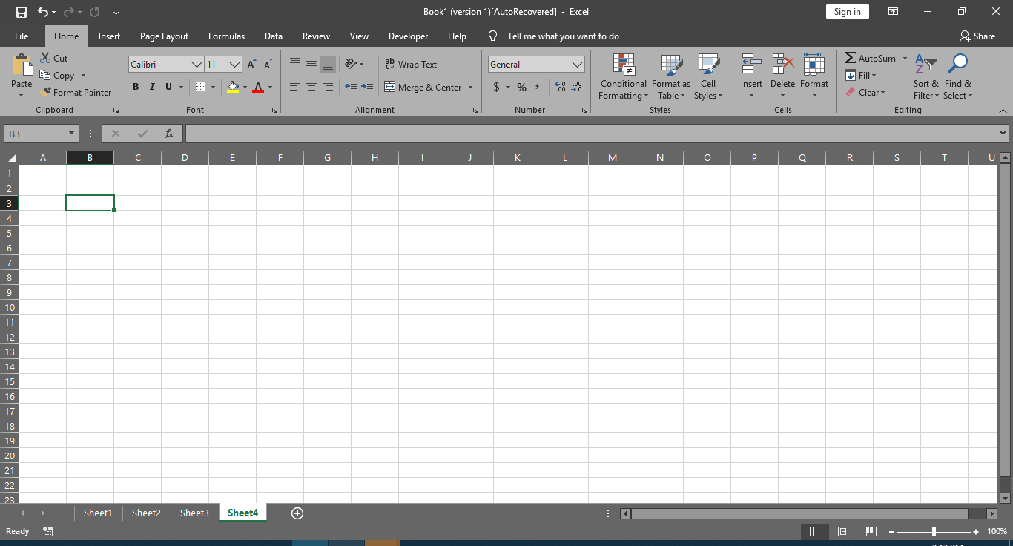
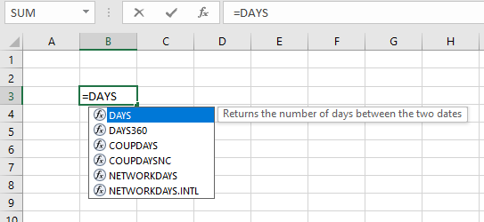
New Themes
There are now three Office Themes that you can apply: Colorful, Dark Gray, and White. To access these themes, go to File >Options > General, and then click the drop-down menu next to Office Theme. Below is an example of Dark Gray theme.
Excel autocomplete isn't as picky as it was before. For example, let's say you want to use the NETWORKDAYS function, but you can't remember how it is spelled. If you just type =DAYS, the autocomplete menu will bring back all of the functions that contain "DAYS," including, NETWORKDAYS. Before, you had to spell the function name exactly. Refer to Fig 3.10 below.
Black Theme
The highest-contrast Office theme yet has arrived. To change your Office theme, go to File > Account, and then click the drop-down menu next to Office Theme. The theme you choose will be applied across all your Office apps. To learn more about Office themes, see Change the look and feel of Office for Windows with Office themes.
Figure 3.10 showing improved autocomplete feature in Excel 2019.

Slide 20
PowerPoint
Microsoft PowerPoint 2019 is the latest version of Microsoft suite of office application developed by Microsoft Corporation. Older versions currently in use are 2010, 2013 and 2016. PowerPoint Presentation is easy to create as it does not need any prior knowledge to learn. This course will teach you basics so that you can develop dynamic and professional presentations.
With this course, you will learn how to...
Start PowerPoint Presentation
Develop a new Presentation
Create a Presentation
Use a Template
Edit Embedded Object

Slide 21
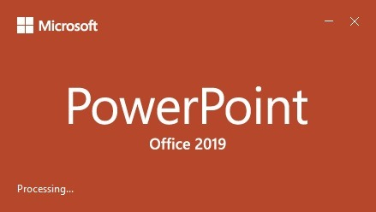
New Features in PowerPoint 2019
Microsoft’s PowerPoint is no doubt one of the most versatile and most used Office applications. From helping people organize charts, statistics, data and information, to helping presenters pass information to an audience in the simplest and most visually appealing way, everybody at one point will make use of the PowerPoint with the application as shown below in Fig 3.2.1.
Figure 3.2.1 showing PowerPoint 2019 application.

Slide 22
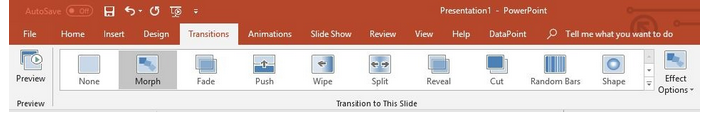
A new transition called Morph has been added to PowerPoint. This powerful transition will allow you to ad smooth movement between one slide to the next in presentation. It’s essentially a straightforward way to get any animation created within seconds. Transitions are one of the interesting features of PowerPoint. You might be used to effects like Honeycomb, Fade, Zoom, Random, Origami, Gallery and so on. If you are, you will love the newly introduced Morph effect
To use Morph, you first duplicate a slide, then move, resize, or edit the objects on the duplicated slide, and then click Transition and morph. Doing this will automatically create a smooth animation from the original slide to the duplicated one as shown in Fig 3.2.2.
Figure 3.2.2 showing Morph from Transitions Tab.

Slide 23
The new Zoom adds a new dynamic navigation option for presenting your PowerPoint 2019 slides where you can jump from a slide or section to another slide or section of your presentation. Zooming has always been a great feature to have around. Not only for PowerPoint presentations but for everything else. The zoom tab has three commands which you can choose from to bring out various interesting effects.
  The summary Zoom
  The Section Zoom
  The Slide Zoom
Zoom proves to be a fun, engaging way to bounce between slides during a presentation and it allows for a more free-flowing approach to a presentation as opposed to the typical slide-by-slide default

Slide 24
Outlook
Microsoft Outlook 2019 is the latest version of Microsoft application suite. Older versions are 2010, 2013 and 2016 developed by Microsoft Corporation. Outlook allows the user not only to send and receive email but manages calendar of important events which are scheduled among others.
In this course, you are going to learn how to...
Use Address Book
Send File Attachment
Use Signature
Set Priority
Replay and forward emails
Customize mail programs
Listen to your emails. When multitasking is in order, Outlook allows you to read your email messages aloud. You can keep up with rest of you other task with your email too as shown below in Fig 3.3.1

Slide 25
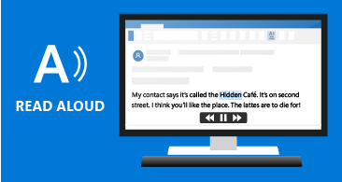
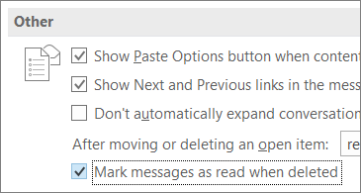
Mark emails as read when deleting If your Deleted Items folder includes unread items, there's now a quick fix to make sure all deleted messages are marked as read.
Outlook 2019 allows you to mark emails as read when deleting from deleted item folder including the unread items as shown below in Fig 3.3.2
Figure 3.3.1 showing email displaying sound from the PC.
Figure 3.3.2 showing mark messages as read when deleted.

Slide 26
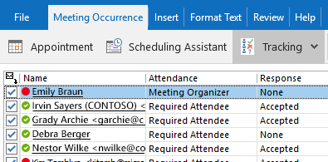
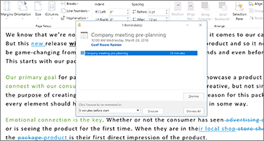
Reminders can be setup in your PC so that it will pop up to remind of you of task you intend to do. Outlook 2019 will flash in the taskbar to get your attention as shown below in Fig 3.3.3.
Outlook 2019 allows you to schedule meetings with people’s responses. See Fig 3.3.4
Figure 3.3.4 showing schedule meetings and responses.
.
Figure 3.3.3 showing reminders popping up.

Slide 27
Summary
New features in Microsoft Office Word 2019
  Tell Me is a new feature which ask your o to type a command to access it instantly
  Microsoft Translator is a new feature added to Word, Excel and PowerPoint
  View a page at a time, side by side
  Use LaTeX in your equations
New features in Microsoft Office Excel 2019
New Functions
CONCAT
IFS
MAXIFS
MINIFS
3D Models

Slide 28
Superscript and Subscript on Quick Access Toolbar
Improved autocomplete
New themes
Black theme
New Features in PowerPoint 2019
A new transition called Morph has been added to PowerPoint.
The new Zoom adds a new dynamic navigation option for presenting your PowerPoint 2019 slides.
New Features in Outlook 2019
Use the system speaker to get email notification
Mark messages as read when deleting
Setting reminders to pop up automatically
Schedule meetings

Slide 29
Review Activities:
What are the main features and benefits of Microsoft 365?
Define Word 2019 and list some new features in Word 2019.
Define Excel and list some new features in Excel 2019.
Define PowerPoint and list some new features in PowerPoint 2019.
Define Outlook and list some new features in Outlook 2019.

Slide 30
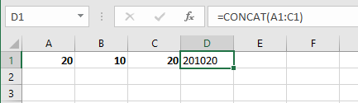
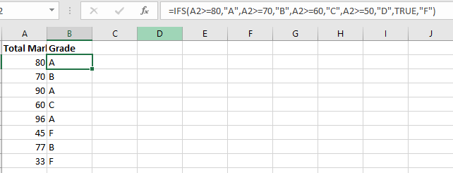
Excel Practical Exercise
Do Practical Exercises on the following functions
CONCAT (refer to page 36)
IFS (refer to page 36-37)

Slide 31
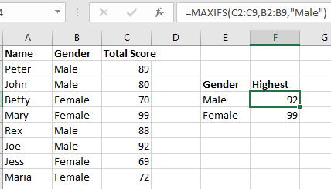
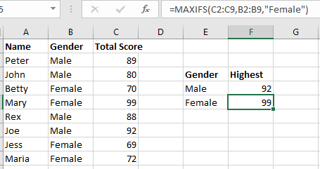
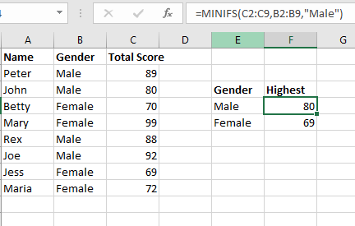
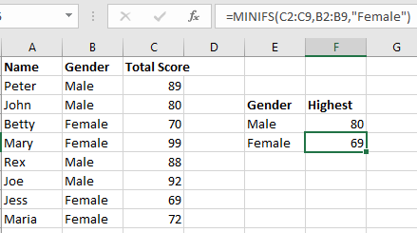
MAXIFS (refer to page 37-38)
MINIFS (refer to page 37-38)

Slide 32
Thank you !!

